Slide 1


Day 19
Math24 (Differential Equations)
Ch 3.4 Repeated Roots; Reduction of Order (Page 167-175)
Elementary Differential Equations and Boundary Value Problems, 10th edition, by William E. Boyce and Richard C. DiPrima, ©2013 by John Wiley & Sons, Inc.

Slide 2


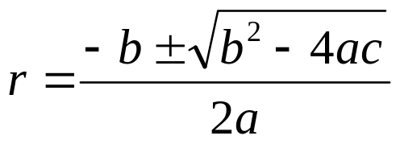

Recall our 2nd order linear homogeneous ODE
where a, b and c are constants.
Assuming an exponential soln leads to characteristic equation:
Quadratic formula (or factoring) yields two solutions, r₁ & r₂:
When b² – 4ac = 0, r₁ = r₂ = -b/2a, since method only gives one solution:

Slide 3

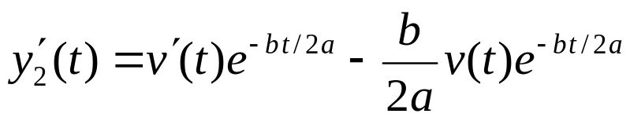
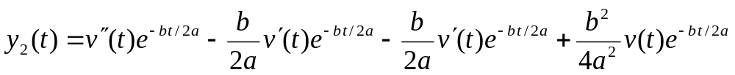
Second Solution: Multiplying Factor v(t)
We know that
Since y₁ and y₂ are linearly dependent, we generalize this approach and multiply by a function v, and determine conditions for which y₂ is a solution:
Then

Slide 4

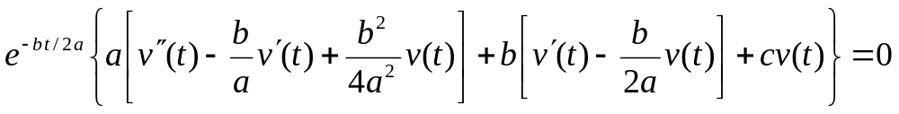
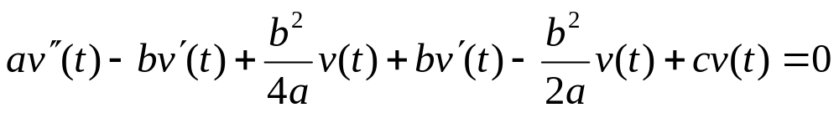
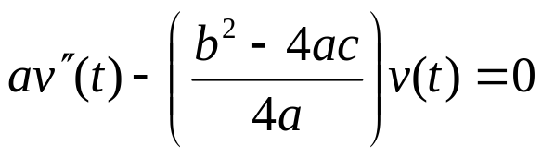
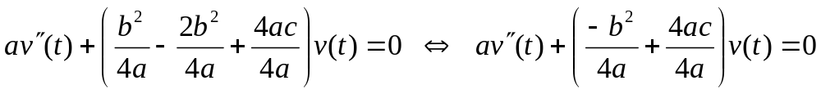
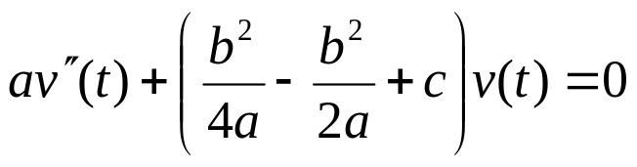

Finding Multiplying Factor v(t)
Substituting derivatives into ODE, we seek a formula for v:

Slide 5

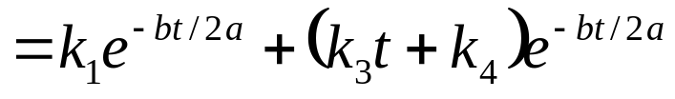

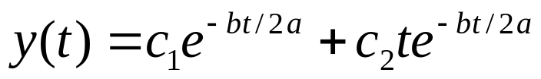
General Solution
To find our general solution, we have:
Thus the general solution for repeated roots is

Slide 6

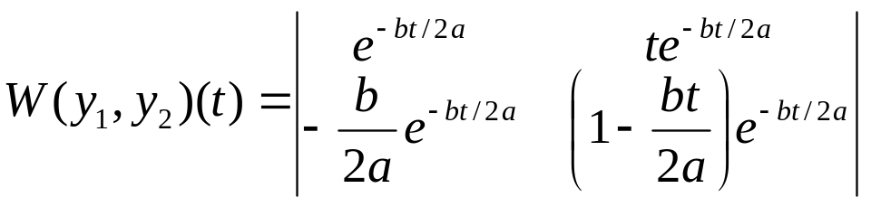
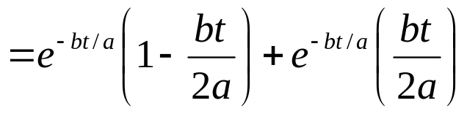

Wronskian
The general solution is
Thus every solution is a linear combination of
The Wronskian of the two solutions is
Thus y₁ and y₂ form a fundamental solution set for equation.

Slide 7






Example 1 (1 of 2)
Consider the initial value problem
Assuming exponential soln leads to characteristic equation:
So one solution is and a second solution is found:
Substituting these into the differential equation and simplifying yields
where are arbitrary constants.

Slide 8
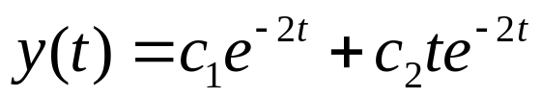



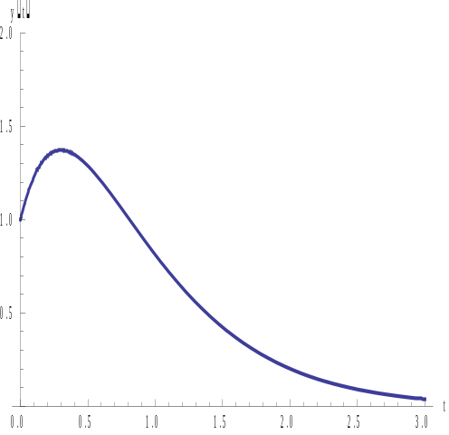
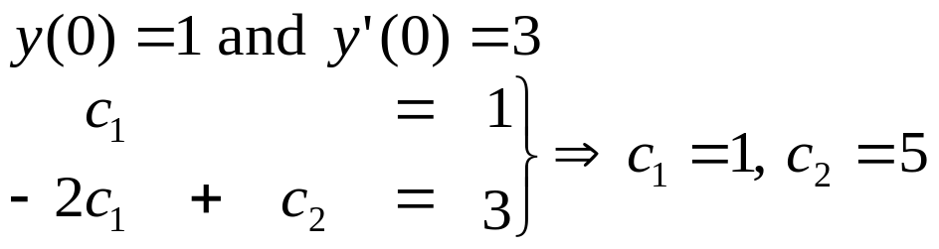


Example 1 (2 of 2)
Letting
So the general solution is
Note that both tend to 0 as regardless of the
values of
Using initial conditions
Therefore the solution to the
IVP is

Slide 9

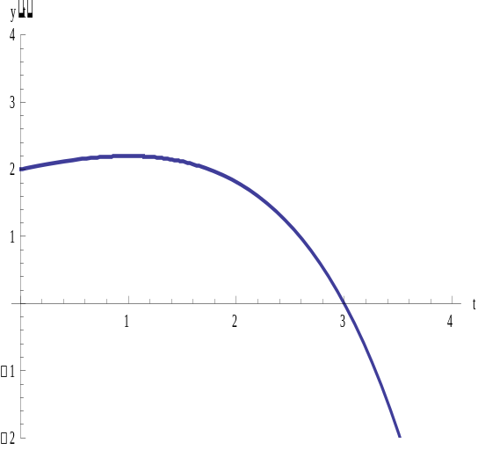

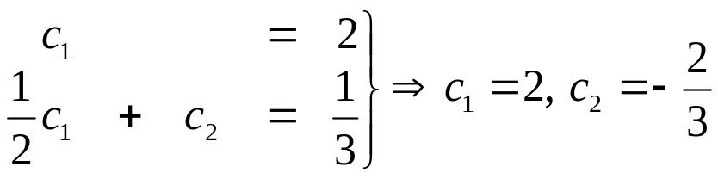
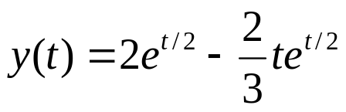
Example 2 (1 of 2)
Consider the initial value problem
Assuming exponential soln leads to characteristic equation:
Thus the general solution is
Using the initial conditions:
Thus

Slide 10


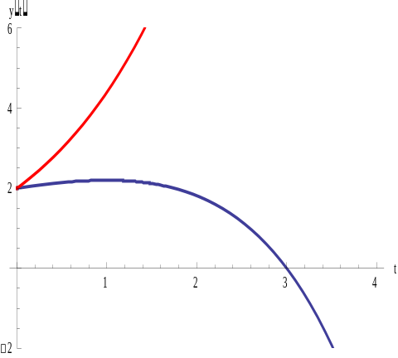


Example 2 (2 of 2)
Suppose that the initial slope in the previous problem was increased
The solution of this modified problem is
Notice that the coefficient of the second
term is now positive. This makes a big
difference in the graph, since the
exponential function is raised to a
positive power:

Slide 11

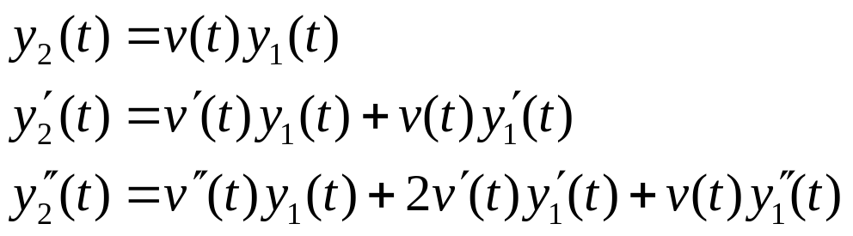

Reduction of Order
The method used so far in this section also works for equations with nonconstant coefficients:
That is, given that y₁ is solution, try y₂ = v(t)y₁:
Substituting these into ODE and collecting terms,
Since y₁ is a solution to the differential equation, this last equation reduces to a first order equation in v′ :

Slide 12




Example 3: Reduction of Order (1 of 3)
Given the variable coefficient equation and solution y₁,
use reduction of order method to find a second solution:
Substituting these into the ODE and collecting terms,

Slide 13

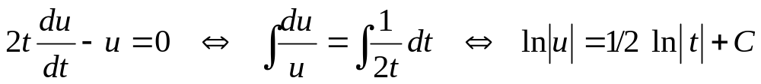
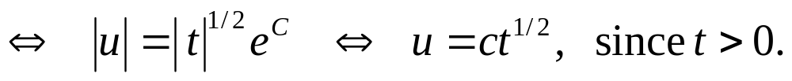


Example 3: Finding v(t) (2 of 3)
To solve
for u, we can use the separation of variables method:
Thus
and hence

Slide 14





Example 3: General Solution (3 of 3)
Since
Recall
So we can neglect the second term of y₂ to obtain
The Wronskian of can be computed
Hence the general solution to the differential equation is

